Slide 1
Introduction to Hadoop

Slide 2
Hadoop and its Ecosystem
Introduction: Hadoop Ecosystem is a platform or a suite which provides various services to solve the big data problems. It includes Apache projects and various commercial tools and solutions. There are four major elements of Hadoop i.e. HDFS, MapReduce, YARN, and Hadoop Common. Most of the tools or solutions are used to supplement or support these major elements. All these tools work collectively to provide services such as absorption, analysis, storage and maintenance of data etc.

Slide 3
Contd..
Following are the components that collectively form a Hadoop ecosystem:
HDFS: Hadoop Distributed File System
YARN: Yet Another Resource Negotiator
MapReduce: Programming based Data Processing
Spark: In-Memory data processing
PIG, HIVE: Query based processing of data services
HBase: NoSQL Database
Mahout, Spark MLLib: Machine Learning algorithm libraries
Solar, Lucene: Searching and Indexing
Zookeeper: Managing cluster
Oozie: Job Scheduling

Slide 4
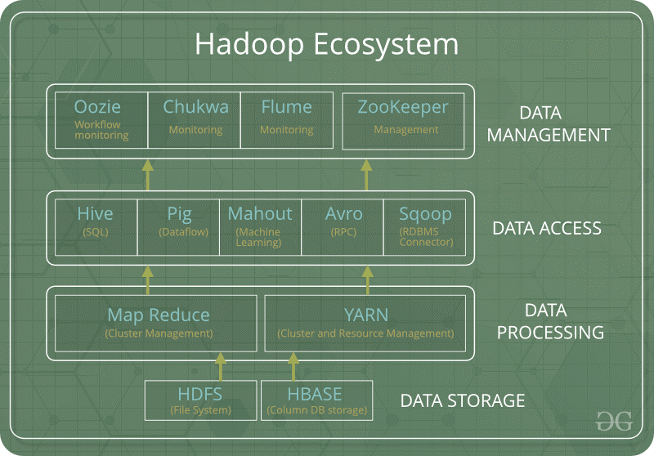
Contd….

Slide 5
Hadoop HDFS
Data is stored in a distributed manner in HDFS. There are two components of HDFS - name node and data node. While there is only one name node, there can be multiple data nodes.
HDFS is specially designed for storing huge datasets in commodity hardware. An enterprise version of a server costs roughly $10,000 per terabyte for the full processor. In case you need to buy 100 of these enterprise version servers, it will go up to a million dollars.
Hadoop enables you to use commodity machines as your data nodes. This way, you don’t have to spend millions of dollars just on your data nodes. However, the name node is always an enterprise server.
Features of HDFS
Provides distributed storage
Can be implemented on commodity hardware
Provides data security
Highly fault-tolerant - If one machine goes down, the data from that machine goes to the next machine

Slide 6
Hadoop MapReduce
Hadoop MapReduce is the processing unit of Hadoop. In the MapReduce approach, the processing is done at the slave nodes, and the final result is sent to the master node.
A data containing code is used to process the entire data. This coded data is usually very small in comparison to the data itself. You only need to send a few kilobytes worth of code to perform a heavy-duty process on computers.

Slide 7
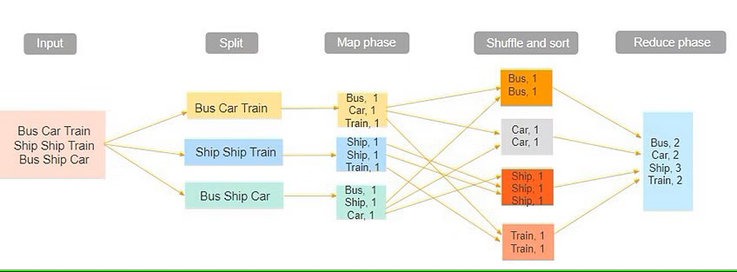

Slide 8
The input dataset is first split into chunks of data. In this example, the input has three lines of text with three separate entities - “bus car train,” “ship ship train,” “bus ship car.” The dataset is then split into three chunks, based on these entities, and processed parallelly.
In the map phase, the data is assigned a key and a value of 1. In this case, we have one bus, one car, one ship, and one train.
These key-value pairs are then shuffled and sorted together based on their keys. At the reduce phase, the aggregation takes place, and the final output is obtained.

Slide 9
Hadoop YARN
Hadoop YARN stands for Yet Another Resource Negotiator. It is the resource management unit of Hadoop and is available as a component of Hadoop version 2.
Hadoop YARN acts like an OS to Hadoop. It is a file system that is built on top of HDFS.
It is responsible for managing cluster resources to make sure you don't overload one machine.
It performs job scheduling to make sure that the jobs are scheduled in the right place

Slide 10
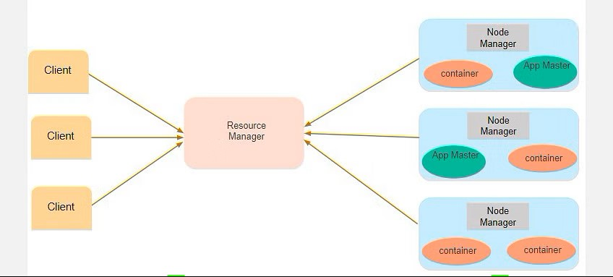
CON…

Slide 11
CON…
Suppose a client machine wants to do a query or fetch some code for data analysis. This job request goes to the resource manager (Hadoop Yarn), which is responsible for resource allocation and management.
In the node section, each of the nodes has its node managers. These node managers manage the nodes and monitor the resource usage in the node. The containers contain a collection of physical resources, which could be RAM, CPU, or hard drives. Whenever a job request comes in, the app master requests the container from the node manager. Once the node manager gets the resource, it goes back to the Resource Manager.

Slide 12
Introduction to Hadoop Tools
Hadoop is an open-source framework written in Java that uses lots of other analytical tools to improve its data analytics operations.
There is a wide range of analytical tools available in the market that help Hadoop deal with the astronomical size data efficiently.
The most famous and widely used tools :
Sqoop
Flume
APACHE Pig
Oozie
HBase

Slide 13
Sqoop
Sqoop is used to transfer data between Hadoop and external datastores such as relational databases and enterprise data warehouses. It imports data from external datastores into HDFS, Hive, and HBase.
The client machine gathers code, which will then be sent to Sqoop. The Sqoop then goes to the Task Manager, which in turn connects to the enterprise data warehouse, documents based systems, and RDBMS. It can map those tasks into Hadoop

Slide 14
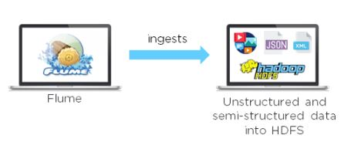
Flume
Flume is another data collection and ingestion tool, a distributed service for collecting, aggregating, and moving large amounts of log data. It ingests online streaming data from social media, logs files, web server into HDFS.

Slide 15
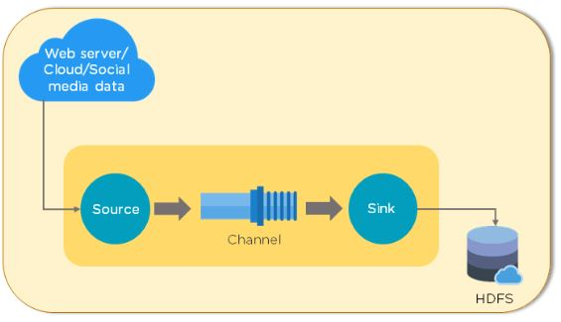
CON…
data is taken from various sources, depending on your organization’s needs. It then goes through the source, channel, and sink. The sink feature ensures that everything is in sync with the requirements. Finally, the data is dumped into HDFS.

Slide 16
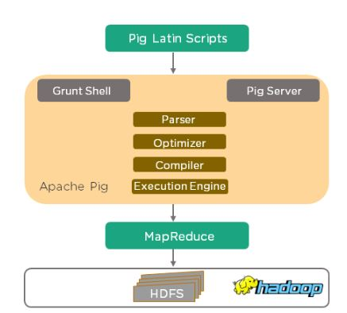
Contd..
Pig’s architecture

Slide 17
Contd..
Pig Latin - This is the language for scripting
Pig Latin Compiler - This converts Pig Latin code into executable code
Pig also provides Extract, Transfer, and Load (ETL), and a platform for building data flow. Did you know that ten lines of Pig Latin script equals approximately 200 lines of MapReduce job? Pig uses simple, time-efficient steps to analyze datasets

Slide 18
Pig
Apache Pig was developed by Yahoo researchers, targeted mainly towards non-programmers. It was designed with the ability to analyze and process large datasets without using complex Java codes. It provides a high-level data processing language that can perform numerous operations without getting bogged down with too many technical concepts.
It consists of:

Slide 19
CON…
Programmers write scripts in Pig Latin to analyze data using Pig. Grunt Shell is Pig’s interactive shell, used to execute all Pig scripts. If the Pig script is written in a script file, the Pig Server executes it. The parser checks the syntax of the Pig script, after which the output will be a DAG (Directed Acyclic Graph). The DAG (logical plan) is passed to the logical optimizer. The compiler converts the DAG into MapReduce jobs. The MapReduce jobs are then run by the Execution Engine. The results are displayed using the “DUMP” statement and stored in HDFS using the “STORE” statement.

Slide 20
Oozie
Oozie is a workflow scheduler system used to manage Hadoop jobs. It consists of two parts:
Workflow engine - This consists of Directed Acyclic Graphs (DAGs), which specify a sequence of actions to be executed
Coordinator engine - The engine is made up of workflow jobs triggered by time and data availability
As seen from the flowchart below, the process begins with the MapReduce jobs. This action can either be successful, or it can end in an error. If it is successful, the client is notified by an email. If the action is unsuccessful, the client is similarly notified, and the action is terminated.

Slide 21
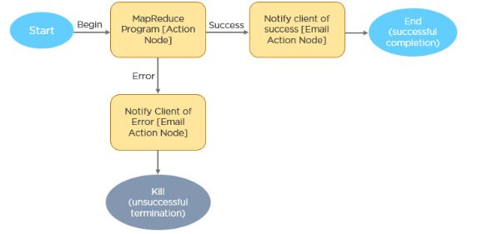
Oozie CON…..

Slide 22
HBase
HBase is nothing but a non-relational, NoSQL distributed, and column-oriented database. HBase consists of various tables where each table has multiple numbers of data rows. These rows will have multiple numbers of column family’s, and this column family will have columns that contain key-value pairs. HBase works on the top of HDFS(Hadoop Distributed File System). We use HBase for searching small size data from the more massive datasets.
Features of HBase:
HBase has Linear and Modular Scalability
JAVA API can easily be used for client access
Block cache for real time data queries

